Slide 1

The Senior Project
Columbus North High School
Step 1: Choosing a Project
Step 2: Proposal Approval

Slide 2
Purpose of Senior Project
Demonstrate skills learned in high school through reflection and application of your expertise
Gain a connection to the community
Apply skills learned in the classroom to the planning and development of your senior project

Slide 3
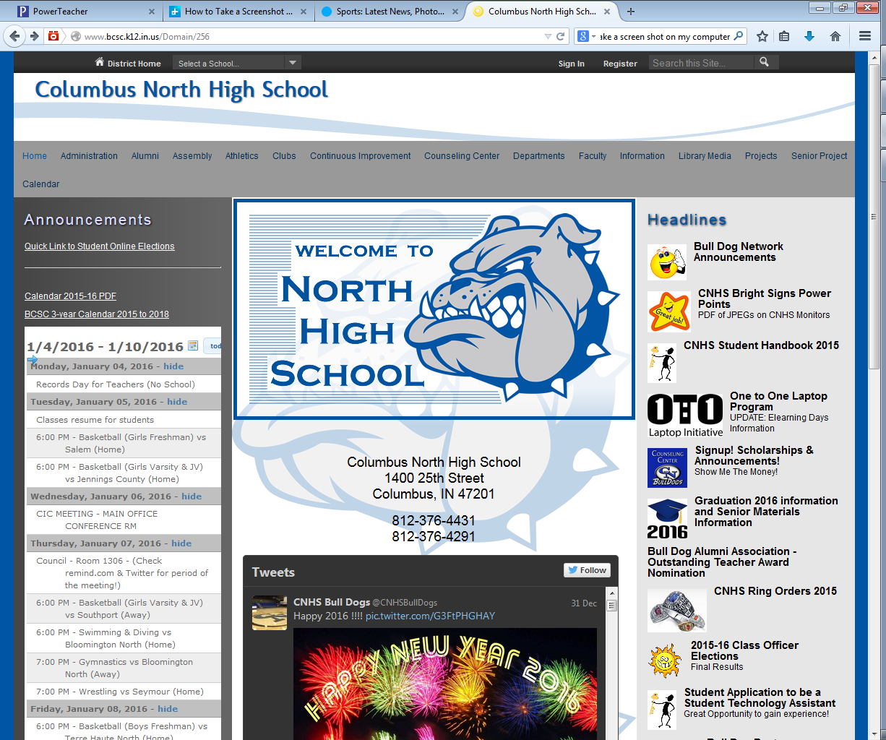
Senior Project Information
Go to the CNHS Website
Click on “Senior Project” Tab

Slide 4
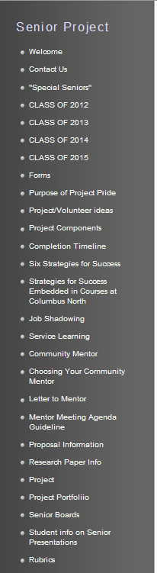
Contact Us
Senior Project Coordinator: Jennifer Hester
812-376-2419
812-314-3833
hestersj@bcsc.k12.in.us
Community Liason: Janet Stephenson
812-376-3108
stephensonj@bcsc.k12.in.us
Find all senior project info on these links!

Slide 5
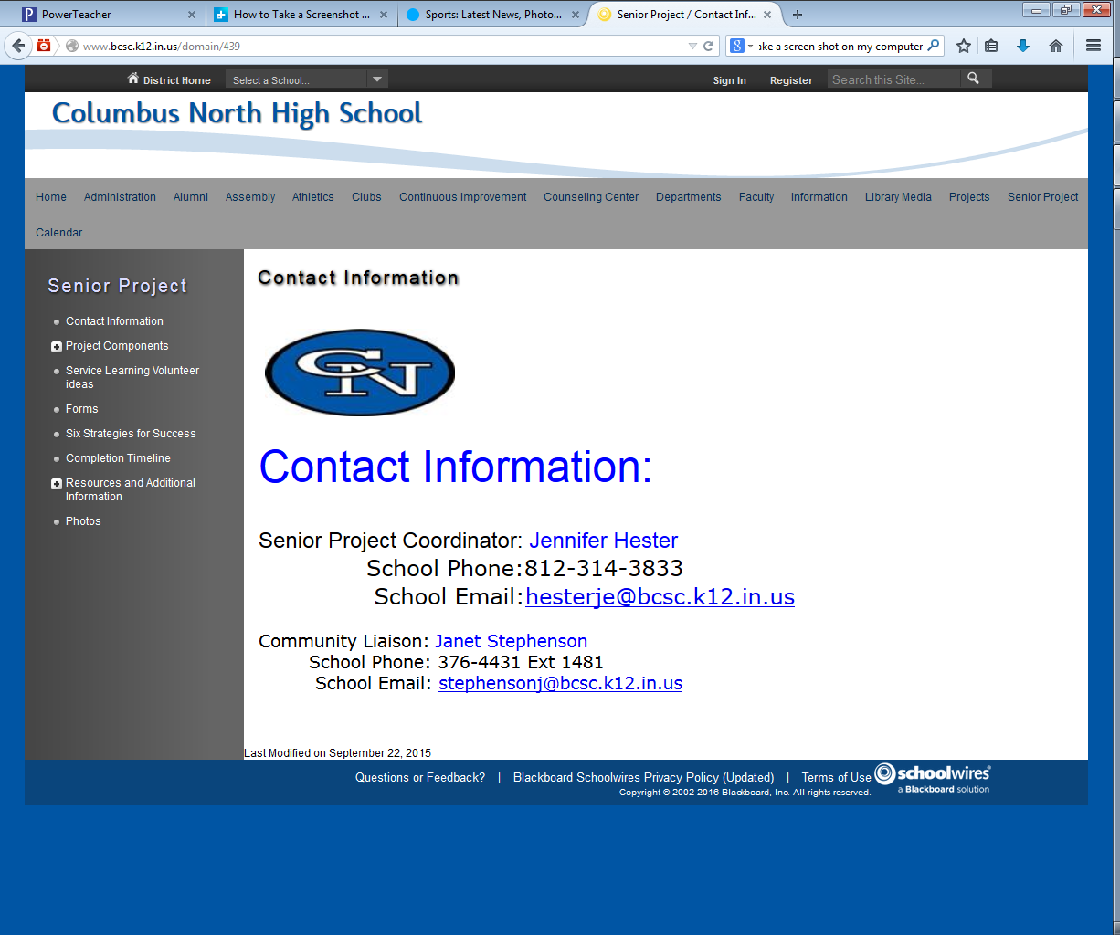

Slide 6

Requirements
Proposal
Paper
Job Shadowing
Service Learning
Portfolio
Presentation

Slide 7
Deadlines: Class of 2016
January 25-29 | Proposal Due
December | Research Paper Due in English Class
March & April | Project Completed & Portfolio Due
December | Presentations

Slide 8
Guidelines for Early Proposals
Accepted on projects that can ONLY be completed during the summer months
Run your idea past Mrs. Hester to see if it qualifies for an early approval
If she approves, complete required proposal paperwork
Present early proposal on:

Slide 9
STEP 1: CHOOSE YOUR PROJECT
Choose a project based on your interests, showcasing your knowledge and skills
Choose a project that is a “STRECH,” demonstrating your ability to extend yourself beyond your existing skills and experiences
Take risks, challenge yourself, step outside your comfort zone
Find a tie-in with the community

Slide 10
ASK YOURSELF…
What am I passionate about?
What career(s) am I interested in pursuing?
Which community organization could use my skills and expertise?
What have been my favorite classes in high school?
How can I tie my senior project together with the skills and experiences I learned in high school?

Slide 11

Time Requirement
Remember, you must complete a minimum of 15 hours (20 hours to eligible for Outstanding) on the project with at least half of the hours spent working and not planning the project
  Example: With a 15 hour project, 8 hours must be spent on the project with a maximum of 7 hours planning the project.
  You may not work on your project during school hours or while school is in session.

Slide 12
Pitfalls To Avoid
Projects that include fund raising:
  Too dependent on your ability to
  market your project
  Too dependent on who shows up and how much they give
  Students often spend more money than they make!
Projects dependent on good weather
Projects that take place in March
  This cuts too close to the presentation

Slide 13
Three Approaches:
Take a talent, skill, or passion that you have and find someone in the community that needs your help in that area.
Find a community organization that needs help and offer your services in an area that will showcase your talents and abilities.
Identify a skill you would like to learn and find someone in the community who would benefit from you learning that new skill.

Slide 14
Project Examples
Organize an Event or Group
  Directing the play Steele Magnolias
  Coordinated mission projects for church
  Teen mom support group
  Update/clean track equipment
  Organized Senior Project fair at CNHS ***
  Brought Invisible Children of Uganda to CNHS
  Organized Angel Tree Christmas gifts at church
  Organized book drive at St. B’s for BCPL
  Art for the elderly at Keepsake Village
  Clean Your Closet for Orphan Grain Train

Slide 15
Project Examples
Construct or Build
  Create a website for a community organization
  Repair or improve an existing school facility
  Build a flight cage for Utopia Wildlife
  Create social media connection for a local mission
  Design poster/advertising for community event
  Create video/PP for freshman orientation at CNHS
  Repair basketball goal in local apartment complex
  Convert closet into a bathroom for local organization
  Complete home maintenance for two elderly families
  Create a history scrapbook for CNHS gymnastics
  Provide routine auto maintenance for low income families

Slide 16
Project Examples
Coach/Teach
  Mentor 4th graders in a math after school program
  Teach special needs class to build cardboard boat
  Teach Chinese to a Girl Scout Troop
  Free clarinet classes to middle school musicians
  Teach a three day journalism workshop
  Teach dance at Foundation For Youth
  Teach pottery at Busy Bees Academy
  Coach 12 yr old volleyball team to combat obesity
  Coach soccer for physically disabled kids
  Coach a cheer squad at Parkside

Slide 17
Project Examples
Learn a New Skill & Teach/Demonstrate to Others
  Examples: Learn to quilt, play a musical instrument, kickbox, lose weight, train for a 5K for the first time, etc.
  After learning the skill, teach, demonstrate, or donate your newly learned skill in the community. Examples:
    Donate your quilt to the elderly
    Play your instrument during a church service
    Run in a charity 5K and collect pledges for the charity
    Teach a group of preschoolers the basics of kickboxing
    Mentor an adolescent who wants to lose weight

Slide 18
STEP 2: PROJECT PROPOSAL
Proposal Brief Form
Extended Proposal Form (typed)
Mentor Acceptance Form
Parent Approval of Community Mentor Form
Facility Usage Form (if applicable)

Slide 19
Purpose of Proposal
Define the focus of the project
Define goals to attain by project’s completion
Provide a rough outline for project’s completion
Identify expenses
Identify “artifacts” to include in portfolio
Confirm your mentor’s identity
Identify benefit to the community
Identify the “learning stretch” this project provides you

Slide 20

Where To Begin
Clarify your project’s vision
  Complete the first draft of your Extended Proposal Form
Select your Community Mentor
  Community Mentors must meet the following criteria:
    Must be at least 21 years of age
    Must be knowledgeable or experienced in field of interest
    Parent(s) must sign the parental mentor approval form. so parent(s) must approve of the mentor.

Slide 21
Role of the Mentor
Has knowledge/experience in your topic area
Willing and able to provide support and guidance through completion of project
Is a support person, not an organizer, director, or manager. YOU ARE IN THE LEAD!
Recommended you meet with mentor at least five times (see suggested meeting agenda handout)

Slide 22
Present Proposal
Complete all required paperwork
Get required signatures
Ask for help when needed
  Mentor
  Bull dog Time Teacher (or other teachers)
  Parents
Present proposal
  During Class
  Deadline for Proposal: Aug 28th

Slide 23
Proposal Format
Participate in an informal conversation with a panel of two or three teachers
Describe your entire project and plans for completion
Answer the panel’s clarifying questions
Receive Feedback: Positive aspects and possible areas of improvement
Revise your proposal if necessary and present revision to your panel leader

Slide 24
Step 3: Research Paper
Will be completed in English class during 1st semester
Must earn a passing grade
  Must keep paper and completed rubric from teacher

Slide 25
Step 4: Complete Project
DO IT!
Don’t put it off!

Slide 26
Job Shadow
2 Different Places
5 hours total
At least 2 hours at each location
2 separate written summaries of 250 words each

Slide 27
Service Learning
Minimum of 10 total hours
Can be split among different locations
500 word summary of your experience

Slide 28
Portfolio
3 Ring Binder
Dividers
Bull Dog time teacher check-off sheet (I check it off)
Blank Binder Due Monday Aug 17th (35 pts. binder, 15 pts. for dividers)

Slide 29
Step 5: Presentation
8-10 minutes speech
Prefer a visual (PowerPoint, poster etc.)
Organized with Introduction, Past (background), Present, Future of your project

Slide 30
QUESTIONS?

